Slide 1













End of Bretton Woods and Beginning of ‘Globalisation’
A Kaveen Surya’s Seminar

Slide 2

Fixed Exchange Rate
A fixed exchange rate is a system where the value of a country's currency is tied (or "pegged") to another major currency, such as the US Dollar (USD)

Slide 3

USD and its value
From the 1960s the rising costs of its overseas involvements weakened the US’s finances and competitive strength. It could not maintain its value in relation to gold.

Slide 4
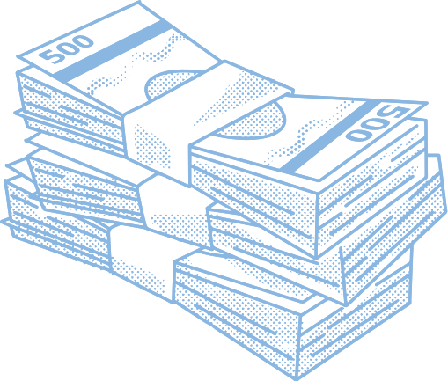
Floating Exchange Rate
A floating exchange rate is a system where the value of a country's currency is determined by market forces that is, supply and demand

Slide 5


Developing Countries and thier debts
Earlier,
Developing
Countries
International
Institutions
Later,
Western Banks
and Lending Institutions
Developing
Countries
This led to periodic debt crises like increased poverty and low wages in countries like Latin America and Africa

Slide 6

Industrial world
and unemployment
The industrial world was also hit by unemployment which make MNCs to shift their focus to low-wage Asian countries for production operation

Slide 7

China and new economic policy
Wages were relatively low in China. Thus they became attractive destinations for investment by foreign MNCs competing to capture world markets

Slide 8

A New style of Economic Growth
The relocation of industry to low-wage countries stimulated world trade and capital flows. the world’s economic geography has been transformed as countries such as India, China and Brazil due to low wages

Slide 9
Thank you very much!
A Kaveen Surya’s Seminar

